Slide 3
True
False
Notes:
Poll Title: Your relationship with your funeral home(s) is extremely important for a successful preneed program. https://www.polleverywhere.com/multiple_choice_polls/LZhOqBeEBFUVilStgEwhK?flow=Default&onscreen=persist

Slide 4
Notes:
Poll Title: Your relationship with your funeral home(s) is extremely important for a successful preneed program. https://www.polleverywhere.com/multiple_choice_polls/LZhOqBeEBFUVilStgEwhK?flow=Default&onscreen=persist

Slide 5
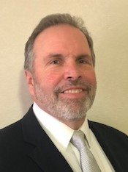
Walt Fuge – Select Producer Ohio
Why a good relationship with the Owner makes the
Preneed Program work
How Walt starts and maintains a good the relationship with the owner
How to do the same at with your Funeral Homeowners
Notes:
His background, 20+ yrs, relationship Jason and Matt, trust

Slide 6
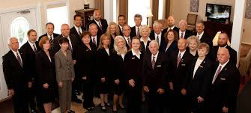
Building the relationship
Tell me how you’ve built the relationships with your funeral homeowners.
Notes:
Walt describes how we are the experts, why is it important to build these relationships. Like the people you work with and making money.

Slide 7
Maintaining the relationships
Breaking bread
Incentives
Recognition
Notes:
Walt discusses how he keeps relationship productive and positive. Use Jason’s call to father describing Walt hitting $1M. Use gift card sparingly.

Slide 8
Key Takeaways
Help the owners get what they want, more preneed
Stay out of Funeral Home internal drama
Show appreciation for support
Notes:
Lead Walt in back and forth, use examples. If I hear ya correctly, helping owners get what they want and staying out of internal drama

