Slide 1
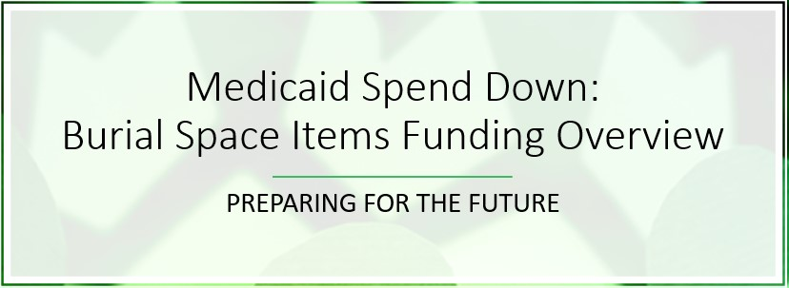

Slide 2
Are you familiar with the Medicaid Spend Down opportunity and the Burial Space Items option?

Slide 3
Spend Down
Spend down simply means reducing assets for a person until the Medicaid limits are reached
A process by which you become eligible for Medicaid by using your own money to pay medical bills until you reach the eligible income limits

Slide 4
Burial Space Item Funding
A burial space or agreement which represents the purchase of a burial space held for the burial of the individual, his or her spouse, or any other member of his or her immediate family is an excluded resource, regardless of value

Slide 6
Notes:
Poll Title: Which of the two below options do you think funeral professionals know more about? https://www.polleverywhere.com/multiple_choice_polls/o7plb6lJ7xkHUDrDRI7qK?flow=Default&onscreen=persist

Slide 7
What’s this session all about?
Provide you with an overview of the Burial Space Items Funding option as it relates to the Medicaid Spend Down opportunity
As applicable in vetted states

Slide 8
Vetted States = BSI Training & Selling Available
Texas
Louisiana
New Mexico
Minnesota
Wisconsin
Ohio
Pennsylvania
Indiana
South Carolina

Slide 9
States In The Works & On The Radar = NOT Vetted
In the works = Credible BSI regulations received
Georgia
Tennessee
Mississippi
On the radar = Researching regulations
Kansas
Alabama
Arizona
Missouri

Slide 10
Perhaps you’re wondering:
Are there really families out there who need to learn about BSI and the Medicaid Spend Down opportunity?
Do preneed sales professionals successfully write BSI contracts?
Why is it mandatory that I attend the full BSI Training with DJ before I can write BSI contracts?
Notes:
Read questions on slide. Before advancing to next slide, share that you will answer questions 1 & 2 with the following example. Click to advance to next slide.

Slide 11
Question #1: Are there really families out there who need to learn about BSI and the Medicaid Spend Down opportunity?

Slide 12
The Baby Boomer Effect
36,390,000 = the number of Baby Boomers age 65+ as of today
As of January 1, 2011, we have 10,000 Baby Boomers turning 65 every day
This surge will last through 2030
Oldest Baby Boomers: 365,000 are/will be age 74 in 2020
Greater number of people than ever before will be faced with the need for Medicaid
Every family facing a Spend Down situation deserves to be educated and served with integrity
Notes:
3,639 days between 1/1/11 and 12/18/2020 = 36,390,000
As of January 1, 2011, we have 10,000 Baby Boomers turning 65 every day
Because of the increasing number of people age 65 and older in the United States, particularly the oldest-old, the number of new cases of Alzheimer's and other dementias is projected to soar. Today, someone in the United States develops Alzheimer's dementia every 66 seconds. By mid-century, someone in the United States will develop the disease every 33 seconds.

Slide 13
Largest Transfer of Wealth in U.S. History
Predicated by the number of Baby Boomers aged 65-74
Hitting 36,520,000 Boomers aged 65-74 on December 31, 2020
10,000 Boomers turning age 65 every day continues until December 31, 2030
Sheer number of Baby Boomers has created the largest transfer of wealth (projected to be $30 trillion+) in U.S. history by:
Passing down assets to children and grandchildren
Spending down assets to qualify for Medicaid
Funeral Directors Life has been planning for this historic event
For a decade we’ve provided education and training on the Medicaid Spend Down opportunity for the BSI option
Notes:
3,652
the wealthiest, and one-time largest, generation in U.S. history,
2019: https://www.cnbc.com/2016/11/29/preparing-for-the-30-trillion-great-wealth-transfer.html
March 13, 2020: https://finance.yahoo.com/news/great-wealth-transfer-means-economy-233527772.html

Slide 14
Question #2: Do preneed sales professionals successfully write BSI contracts?

Slide 15
BSI Success – Jake Kramar August 2020
Call came to funeral home; kids want to pre-arrange for their dad
Explained in meeting that dad was going into a nursing home and starting his spend down for Medicaid
Switched from just dad’s preneed to BSI for the kids, etc.
Shared with all 3 kids what was legally allowed regarding BSI
Explaining to all of dad’s kids at the same time was the perfect storm
Remember the fun game called “The Telephone Game”?
This time, by having all kids present, they asked questions, everyone heard the same answers, they talked amongst themselves, and then made the decision to do the BSI contracts; real-time with no delay = perfect storm
Completed a total of 6 contracts (1 preneed, 5 BSI) within a few hours during one meeting

Slide 16
BSI Success – Jake Kramar
$60,000 for 6 contracts tied to a Medicaid Spend Down with Burial Space Items (BSI)
Dad purchased his full preneed funeral and BSI contracts for 3 children and 2 of their spouses
Notable facts
The average age for these sales was 65 years
Policy size was $10,000
Burial Space Items included on BSI contracts
Plot, headstone and opening & closing

Slide 17
BSI Advice
Keep BSI front-of-mind with every family
Especially when kids are planning for their parents
Give BSI brochure to every family, every time
You never know when an appointment will shift from one contract for an elderly individual to multiple contracts for younger family members; or think of it this way:
From helping dad spend down $10,000 towards qualifying for Medicaid to
Dad spending down $60,000 and qualifying for Medicaid

Slide 18
Question #3: Why is it mandatory that I attend the full BSI Training with DJ before I can write BSI contracts?

Slide 19
Why is BSI Training mandatory?

Slide 20
Our plan:
Spend Down Opportunity
Burial Space Items
How BSI benefits:
The families we serve
You and the funeral home’s you represent
BSI: Educating Families

Slide 21
Spend Down
Spend down simply means reducing assets for a person until the Medicaid limits are reached
A process by which you become eligible for Medicaid by using your own money to pay medical bills until you reach the eligible income limits

Slide 22
Burial Space Item Funding
A burial space or agreement which represents the purchase of a burial space held for the burial of the individual, his or her spouse, or any other member of his or her immediate family is an excluded resource, regardless of value

Slide 23
Our objective with BSI
To help the families we serve make wise financial decisions for their and their family's future by helping them spend down assets through the Burial Space Items Funding exclusions to qualify for Medicaid

Slide 24
Financial Impact
It is important to understand the financial impact of BSI:
To the families you serve, and
To you

Slide 25
For Families
What is the impact (the benefit) of BSI to the families you serve?
The Baby Boomer Effect we covered earlier but it’s worth a second look!

Slide 26
The Baby Boomer Effect
36,390,000 = the number of Baby Boomers age 65+ as of today
As of January 1, 2011, we have 10,000 Baby Boomers turning 65 every day
This surge will last through 2030
Oldest Baby Boomers: 365,000 will be age 74 in 2020
Greater number of people than ever before will be faced with the need for Medicaid
Every family facing a Spend Down situation deserves to be educated and served with integrity
Notes:
3,639 days between 1/1/11 and 12/18/2020 = 36,390,000
As of January 1, 2011, we have 10,000 Baby Boomers turning 65 every day
Because of the increasing number of people age 65 and older in the United States, particularly the oldest-old, the number of new cases of Alzheimer's and other dementias is projected to soar. Today, someone in the United States develops Alzheimer's dementia every 66 seconds. By mid-century, someone in the United States will develop the disease every 33 seconds.

Slide 27
The Baby Boomer Effect
36,390,000 = the number of Baby Boomers age 65+ as of today
As of January 1, 2011, we have 10,000 Baby Boomers turning 65 every day
This surge will last through 2030
Oldest Baby Boomers: 365,000 will be age 74 in 2020
Greater number of people than ever before will be faced with the need for Medicaid
Every family facing a Spend Down situation deserves to be educated and served with integrity
Notes:
3,639 days between 1/1/11 and 12/18/2020 = 36,390,000
As of January 1, 2011, we have 10,000 Baby Boomers turning 65 every day
Because of the increasing number of people age 65 and older in the United States, particularly the oldest-old, the number of new cases of Alzheimer's and other dementias is projected to soar. Today, someone in the United States develops Alzheimer's dementia every 66 seconds. By mid-century, someone in the United States will develop the disease every 33 seconds.

Slide 28
For You
How can helping families with BSI help you as well?
Happy families…who talk to other families
Referrals
Attorney referral network
Serve more families
Lower average ages
Single Pay
Irrevocable
Bringing greater value to families – and their families’ future

Slide 29
BSI: Educating families

Slide 30
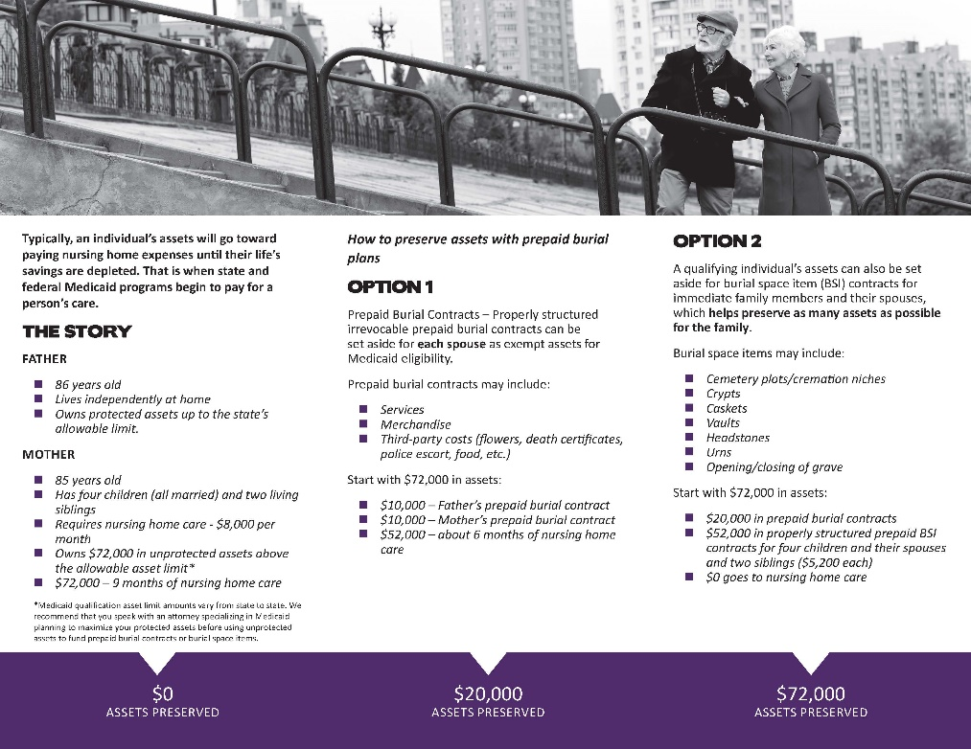
Every Family Needs This Brochure (Every Time!)

Slide 31
BSI conversation with families
Scripting is provided with training

Slide 32
Remember, BSI Training is mandatory before selling BSI preneed contracts

Slide 33
